Slide 1
Final Project – Gray Image Compression
Professor : Chen-Hao Chang
Student : Kuan-Ting Tu
Notes:
KT Gray Image Compression (.ktic)

Slide 2
Outline
Encoder Architecture
Discrete Wavelet Transform
Quantization
Difference
Data Compress - Huffman code

Slide 3
Encoder Architecture
Gray Image
Lossless
compress
Discrete Wavelet Transform
(DWT)
Data compression
(Huffman Coding)
Lossy
compress
Quantization
(Dead-Zone Scalar Quantization)
Difference
u_image.ktic
Figure1 Encoder Architecture

Slide 4
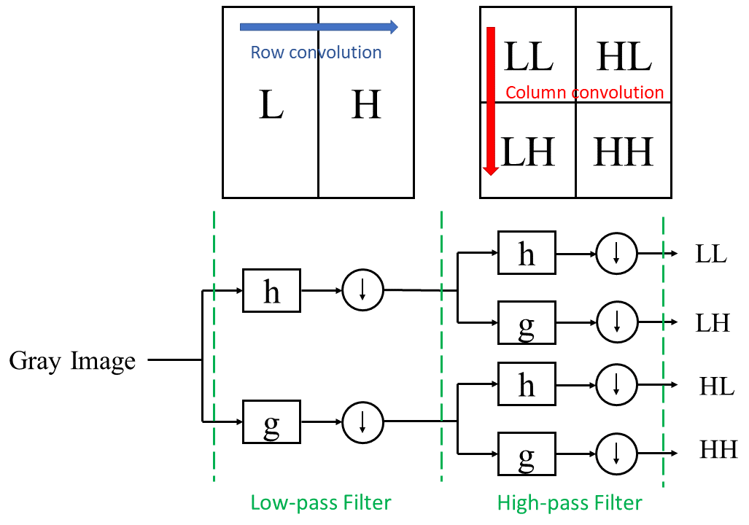
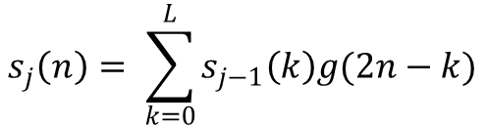
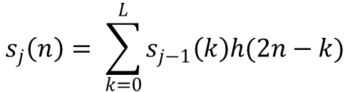
Discrete Wavelet Transform
Figure2 Discrete Wavelet Transform
$$s_{j}\left(n\right)= \sum_{k=0}^{L}{s_{j−1}\left(k\right)h(2n−k)}$$
$$s_{j}\left(n\right)= \sum_{k=0}^{L}{s_{j−1}\left(k\right)g(2n−k)}$$

Slide 5
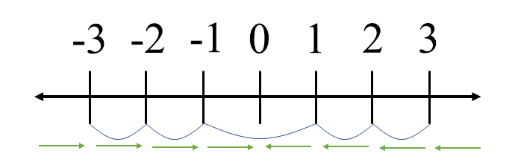
Quantization
Figure3 Dead-Zone Scalar Quantization

Slide 6
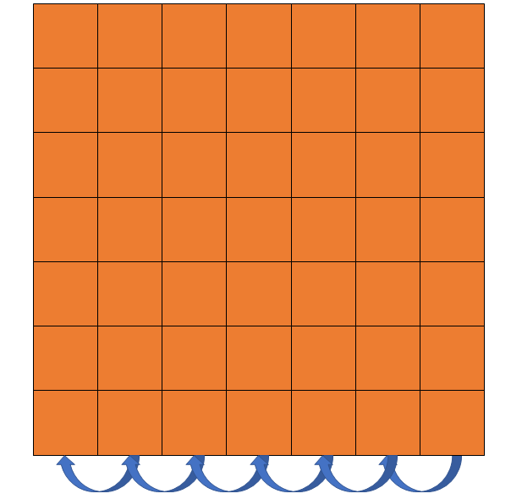
Difference
Figure4 Difference
Notes:
可以使資料更集中在0、15兩個數字

Slide 7
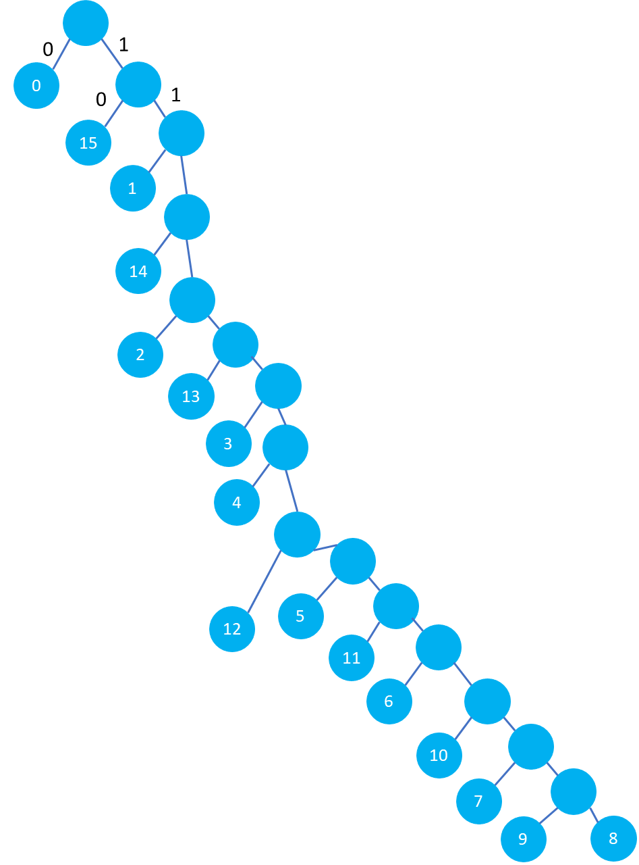
Data Compress - Huffman code
Value | Huffman code | Value | Huffman code
0000 | 0 | 1000 | 111111111111111
0001 | 110 | 1001 | 111111111111110
0010 | 11110 | 1010 | 1111111111110
0011 | 1111110 | 1011 | 11111111110
0100 | 11111110 | 1100 | 111111110
0101 | 1111111110 | 1101 | 111110
0110 | 111111111110 | 1110 | 1110
0111 | 11111111111110 | 1111 | 10
Figure5 Huffman Tree
Table1 Huffman codes
Notes:
以4bits為1個symbol進行編碼，共16種可能
基於簡化硬體複雜度原因，不進行Huffman coding中的機率偵測進行編碼

Slide 8
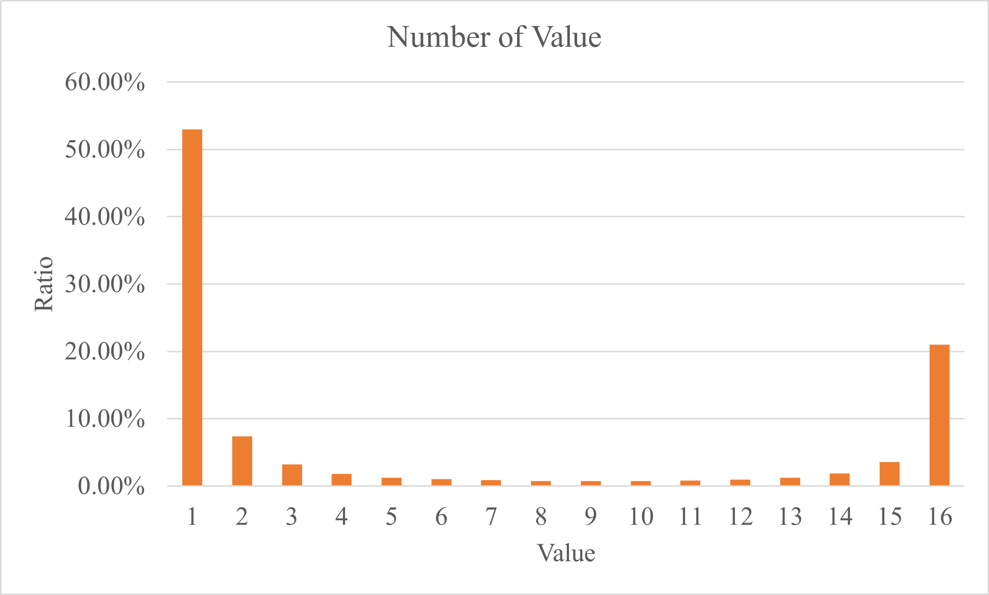
Data Compress - Huffman code
Figure6 Number of Value
Notes:
統計各數字出現的比率

